Slide 1
Single Engine Failure Testing
Gideon Mendelson

Slide 2
Purpose
Brief what is Vmca
Brief the basic theoretical concept of Vmca
Show an example of predicting Vmca static and HQ
Brief the Vmca FTT

Slide 3
Overview
Vmca definition
Vmca test attitude
Theoretical concept
Control power definitions
Predicting βtrim, δa trim and δr trim for stable flight
Predicting βtrim δa and φ for stable flight (no use of rudder)
Predicting HQ using RSmith criteria
Vmca FTT
Safety

Slide 4
Test Attitude
The MIL STD 1797A states :
“no single failure of any component or system shall result in dangerous or intolerable flying qualities”
One of the most critical failure situations is a multi engine a/c with critical engine failure and the influence on stability, flying qualities and handling qualities.
This type of testing is risky and therefore we must use the predict, test and validate method.
Because of the risk we also employ extensively the build up approach, which is progress from low to high risk.
Notes:
Critical engine means the engine in which a critical engine problem will mostly effects the a/c (in 3 or more engines a/c it means the outboard engines failure).

Slide 5
Test Attitude (cont’)
Single engine failure HQ is conducted with the same HQ FTT’s we briefed which is the 3 phases method:
  Phase I - low bandwidth evaluation.
  Phase II - High bandwidth evaluation (HQDT)
  Phase III - Operational evolution
Failure states situation are unique because they tend to develop fast and the pilot is not prepared for the emergency situation. The result is time delay between the failure and the corrective actions.
The MIL STD 1797A defines for testing, a period of one to four seconds after failure occurs and before pilot correcting inputs are applied.
Notes:
In case of a engine failure the pilots need to identify which engine failed and what the nature of the failure. It takes time, mean time the a/c has dynamic response due to the large asymetric thrust.
Usually it takes the pilot about one second before the first control input is applied.

Slide 6
Test Attitude (cont’)
The engine failure situation could restricts the flight envelope in three ways:
  Ability to fly stable (“trimmed”) flight (MIL STD 1797A definition - maintain pitch control and constant heading flight).
  Ability of the a/c to recover from a transient motion following engine failure.
  Reduced HQ due to the large side slip. The HQ could be so degraded they can impair the ability of the a/c to come to a safe landing.
Notes:
These are the three components which defines Vmca.

Slide 7
Test Attitude (cont’)
Usually the most critical situation for engine failure is in low airspeed, low altitude due to the reduced effectiveness of the control surfaces, and the higher thrust of the remaining engines (high thrust asymmetry).
Notes:
Low airspeed reduced significantly the ability of the rudder and vertical stabilizer to count the asymetric thrust.
Low altitude increase the thrust of the operating engine and therefore increase asymetric thrust.

Slide 8
Vmca
The engine failure testing goal is :
  Determine the minimum airspeed at which pilot can “trim” engine out airplane, using the controls which are available allowing a suitable margin of controls for arresting the initial transient response, maneuvering the a/c, and coping with gusts (static).
  Determine the minimum airspeed at which the transient response to engine failure could be safely arrested (dynamic).
  Determine the minimum speed at which tolerable HQ resulting from engine failure could be achieved (HQ).
The minimum of the three is defined as Vmca
(Velocity Minimum Control Air).

Slide 9
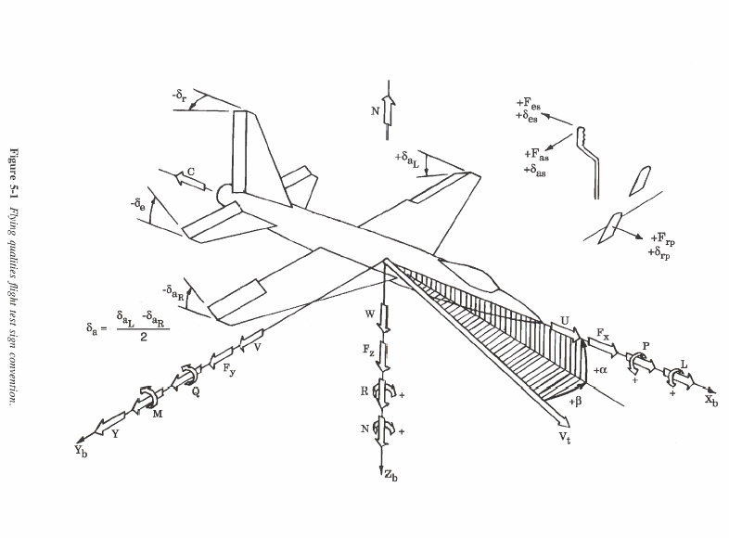
sign convention
Notes:
Here you can see the common sign convention, I hope you are familiar with them.
The most important signs are:
Pitch axis- Rotation is about Y axis, Pitch angle signed θ (up is +), Pitch rate signed Q (up is +)
Roll axis – Rotation is about X axis, Bank angle signed φ (right is +), Roll rate signed P (right is +)
Yaw axis – Rotation is about Z axis, Yaw angle signed ψ (right is +), Yaw rate signed R (right is +)
Angle between X axis and the relative wind on the XZ plane called angle of attack and signed α (up is +)
Angle between X axis and the relative wind on the XY plane called angle of sideslip and signed β
(β in the right ear is +)

Slide 10


Theory background
Here are the equations of and
Notes:
β dot and R dot are angular accelerations.
The Ty is the side power created by the effect of the β on the engine (the axis of the engine is directed with β to the side and generate side force) and the force crated by the rudder due to β.
Nt is the moment of inertia around the Izz axis, we can see it at large when a/c is not loaded (small Izz) and low altitude (high asymetric thrust and yaw moment)

Slide 11
Theory background (cont’)
We can convert the to yaw moment equation by multiplying with I_{zz}
We can convert the to side force equation by multiplying with mv_{t}.

Slide 12
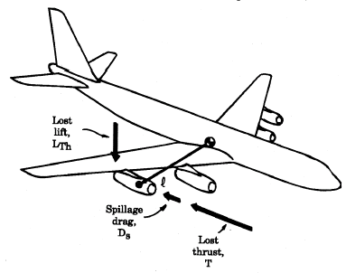

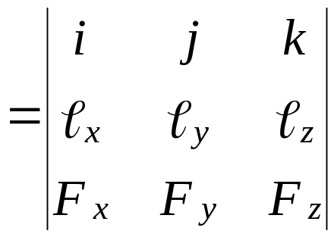
Theory background (cont’)
T – Thrust
Ds – Spillage drag
Lth – Lost of lift
The forces and vectors of an engine out situation are:
Roll
Pitch
Yaw
Notes:
There are basically 3 forces in case of engine failure. The first is the lost of thrust signed T, the second is the spillage drag due to the engine drag because of the engine cross section signed Ds, the third is the lost of lift due to change in exhaust air and due to the lost of lift due to engine thrust vector which has some lift component.
The F sign is the force vector of all forces above. l is the position vector of the engine with regard to the a/c CG.
i, j and K are unit vectors in the 3 axis.
A vector product of l×F give us the moment in every axis

Slide 13
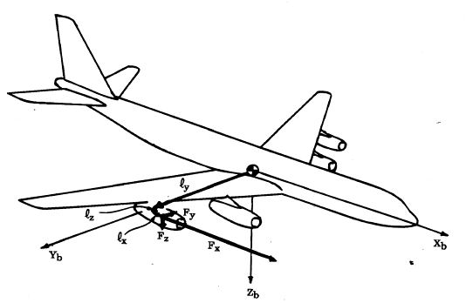



Theory background (cont’)
Moments
Roll
Pitch
Yaw
F is the sum of thrust, spillage drag and lost of lift
Thrust value we know from engine thrust model, spillage drag and lost of lift are hard to predict and must be validated in flight test
Notes:
We can easily see the Fx force vectors and the ly position vector are extremely large compare to the other vectors and ly times Fx gives us a huge number.
Therefore the yawing moment NT is the most significant factor in an engine failure situation.

Slide 14
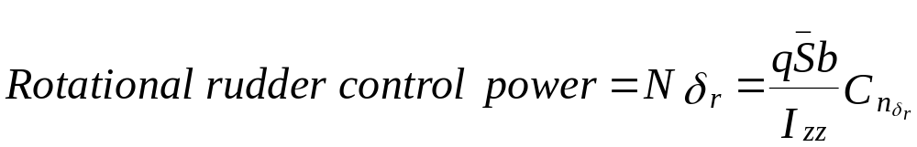
Control power
Recall the first requirement from Vmca –
“Determine the minimum airspeed at which pilot can “trim” engine out airplane, using the controls which are available allowing a suitable margin of controls for arresting the initial transient response, maneuvering the a/c, and coping with gusts”
The term “minimum speed” is defined by the MIL STD 1797A as the lowest speed with left over control authority.
Lets see what is a rotational control authority :
Notes:
Control power in simple words is how effective is the control
The control generates force and moment.
We we’ll analyze the rudder control power and the rudder generates yaw moment N and side force Y.

Slide 15
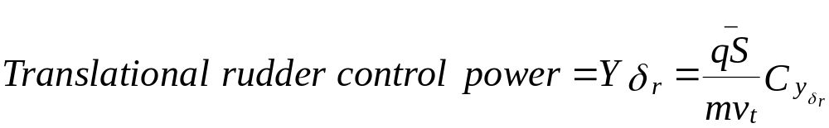

Control power (cont’)
And the force control power:
We’ll call both translational and rotational powers as control power
We can see the control power is directly proportional to the control power derivative
The behavior of one of the control power derivatives is on the next chart :
Notes:
We assume the behavior of the control power derivative to be linear in the range of airspeeds during flight. From flight test we know this is very much true.

Slide 16
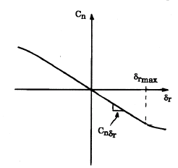
Control power (cont’)
The MIL STD defines the control power for a trimmed flight won't exceed 75% of the max force or deflection of the control.
Notes:
The rest 25% are to have extra control to counter rates and unstable flight conditions like wind gusts and aggressive corrections by the pilot.

Slide 17
Predicting β_{trim} , δ_{a trim} , δ_{r trim}
Here are the relevant restricted equations.
Ty (which is basically the asymmetric thrust) substituted by Fy:
Notes:
Before we go and fly risky Vmca flight test we must have a prediction of the static (trimmed) Vmca. I would like to emphasize the term “trimmed flight”, it does not mean it is hands off the controls but means the pilot can apply stable input to the controls which will allow the a/c to get to a stabilized flight.
Recall the static Vmca could be because of β limit or δr limit or δa limit. We must first predict what will be the airspeed in each case one of the above variables (β, δr, δa) is at its limit.
The following slides will show how we are calculating those speeds limits.
Here we have the equations of roll acceleration P dot, β rate (β dot) and yaw acceleration R dot.

Slide 18
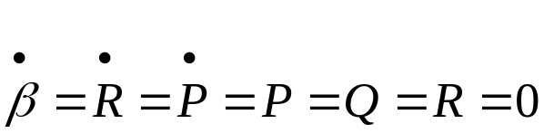
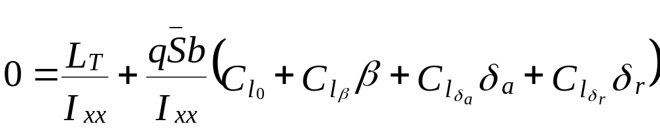
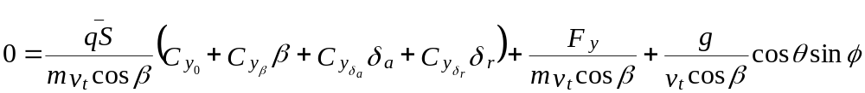
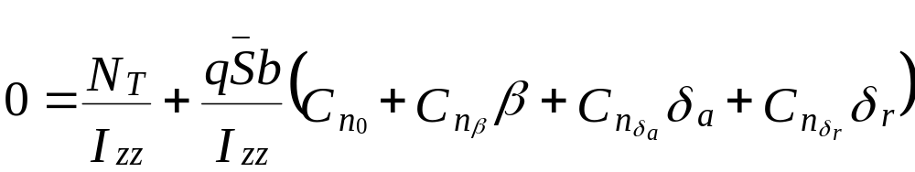
Predicting β_{trim} , δ_{a trim} , δ_{r trim} (cont’)
Since we are interested in predicting the values of β, δa and δr for uncelebrated, 1g, constant heading flight , we can assume →
Notes:
Since we are talking about “trimmed” and steady flight (as part of the static Vmca prediction) we can assume β dot = R dot = P dot = P = Q = R = 0
This assumption make the equations much shorter.

Slide 19
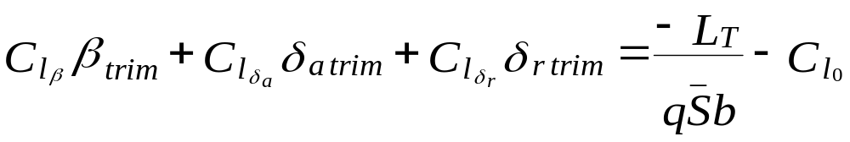
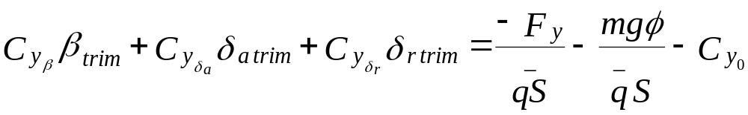
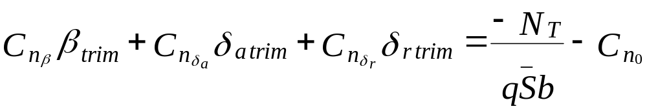
Predicting β_{trim} , δ_{a trim} , δ_{r trim} (cont’)
Now we divide yellow equation by Vtcosβ, and orange and light blue with Ixx and Izz.
We’ll multiply by 1/qs all equation and by “m” the yellow equation.
We can assume small pitch angles so cosθ=1 and sinφ=φ
And finally because it is a 1g, unaccelerated constant heading flight,
β=β trim, δa=δa trim and δr=δr trim.
Rearrange →
Notes:
Now we do some mathematical massage to the equations
Assume cos θ =1 (which make sense) because even engine failure is most risky during go around or takeoff and the pitch angle is usually below 15 degrees.
We can also assume sin φ = φ because we assume level wings or small bank angles.
Finally we rearrange the equations in a way we can solve for β, δr and δa.

Slide 20
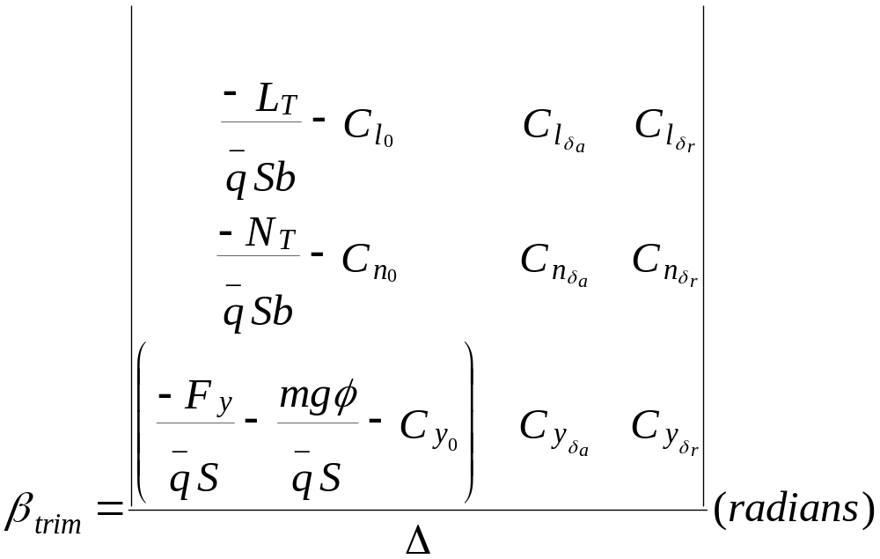
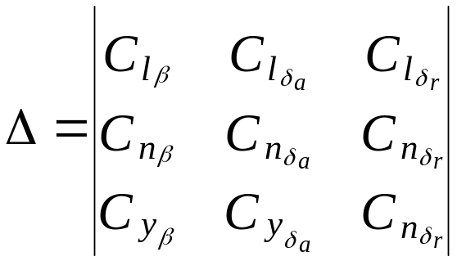
Predicting β_{trim} , δ_{a trim} , δ_{r trim} (cont’)
Solving for β, δa and δr (using Cramer’s rule) →
Notes:
Using Cramer rule and solving for β as the dependant variable and q as the independent variable.

Slide 21
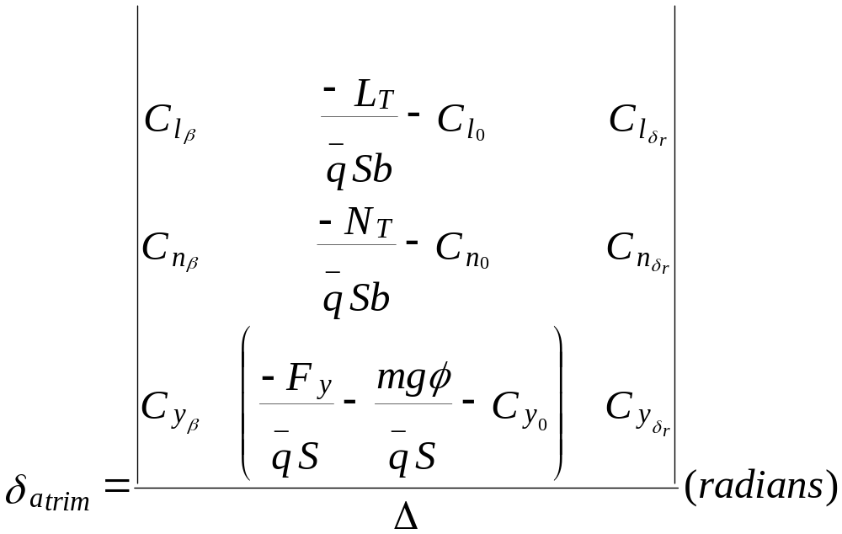
Predicting β_{trim} , δ_{a trim} , δ_{r trim} (cont’)
Notes:
Solving for δa is pretty much the same.

Slide 22
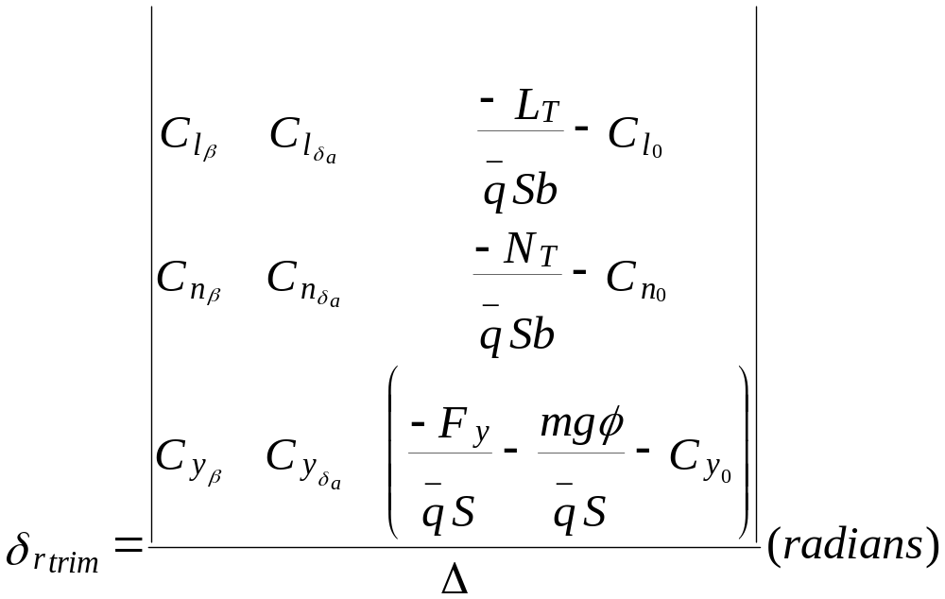
Predicting β_{trim} , δ_{a trim} , δ_{r trim} (cont’)
Notes:
And also to δr

Slide 23
Predicting β_{trim} , δ_{a trim} , δ_{r trim} example
Let’s now show an example of calculating the lowest speed an a/c can fly trimmed constant heading flight with engine out using the method I briefed.
We’ll show the minimum predicted speed as a function of weight (mg), yawing moment N_{T}, and bank angle φ.
We’ll create plots of β trim, δa trim and δr trim versus q. From this plots we will be able to take the lowest possible predicted engine out trimmed speed.
This is the first part of a Vmca testing and a necessary step before flight test starts.
Notes:
To make things more clear I’ll show now an example with numbers which will help to understand the whole process.
At the end we’ll plot charts of β, δr, δa with regard to q and from those plots we’ll be able to determine the lowest predicted speed for every factor (β, δr, δa)

Slide 24
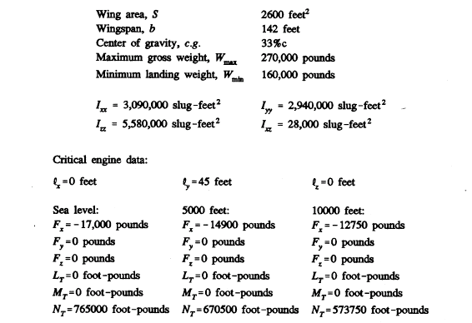
Predicting β_{trim} , δ_{a trim} , δ_{r trim} example (cont’)
The data are of B707, we have also data for SL, 5000 and 10000 feet:

Slide 25
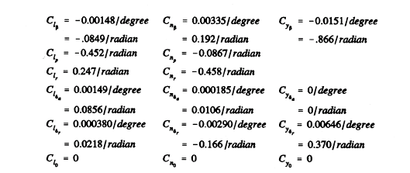
Predicting β_{trim} , δ_{a trim} , δ_{r trim} example (cont’)
Cl
Cn
Cy

Slide 26

Predicting β_{trim} , δ_{a trim} , δ_{r trim} example (cont’)
First let’s calculate the yawing moment using the moment equation →
The worst yawing moment is at sea level and the reason is the higher thrust at lower altitude
Notes:
First we’ll calculate the yawing moments at sea level, 5000 ft and 10000 ft.
Obviously the biggest moment is at sea level due to the higher thrust of the remaining engine.

Slide 27
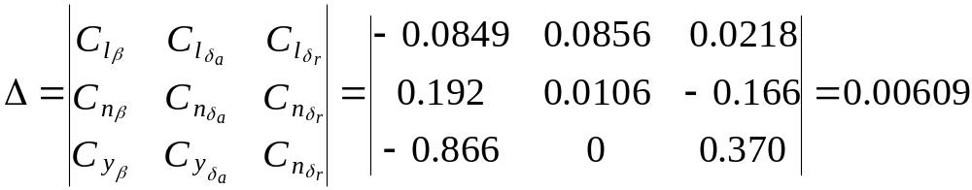
Predicting β_{trim} , δ_{a trim} , δ_{r trim} example (cont’)
Now we’ll calculate Δ →
Notes:
Taking the determinant of the denominator.

Slide 28
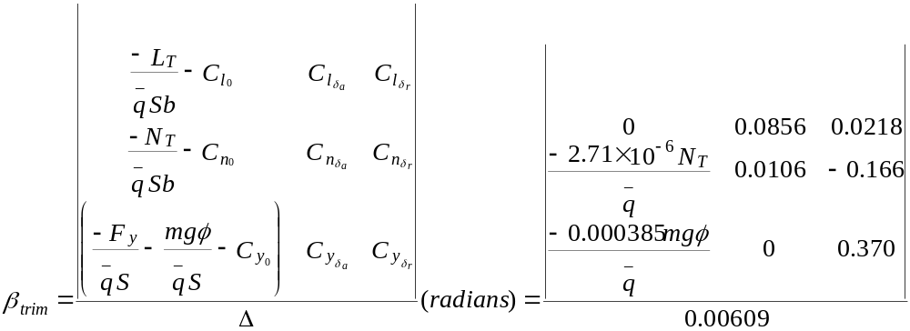
Predicting β_{trim} , δ_{a trim} , δ_{r trim} example (cont’)
Now we’ll calculate β trim for engine out flight →
Notes:
Using Cramer rule calculating the nominator
Leaving Nt, q and mgφ in a variable form, I’ll show later why.

Slide 29
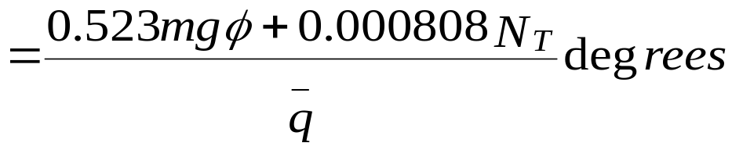
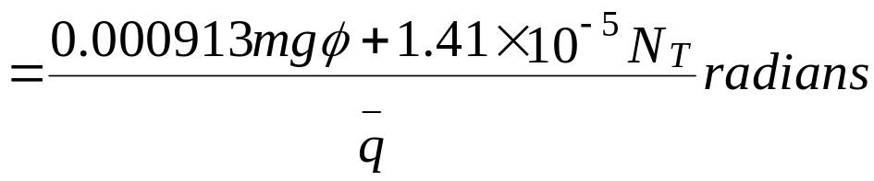
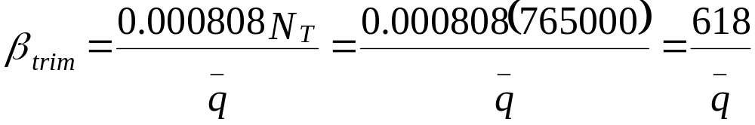

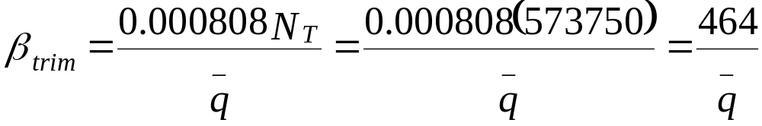
Predicting β_{trim} , δ_{a trim} , δ_{r trim} example (cont’)
Setting φ=0 (level wings) and values for N_{T} at SL, 5000 and 10000 feet.
SL
5000 feet
10000 feet
Notes:
The results in the (pink ban) are in the units of degrees and in the (yellow ban) in the units of radians.
Now setting φ = 0 (level wings) which zeroize the mgφ component.
And substitute Nt with the yawing moments we calculated before in sea level (yellow ban), 5000 ft (pink ban) and 10000 ft (the light blue ban) .
Now we have for each altitude β trim with respect to the current q.

Slide 30
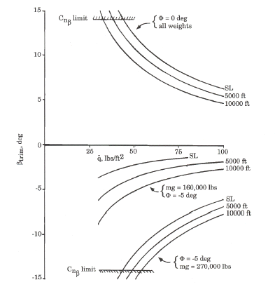
Predicting β_{trim} , δ_{a trim} , δ_{r trim} example (cont’)
Plotting β trim vs q →
Notes:
Plotting β for q for the three different altitudes
We’ll analyze the plot later on but first we need to calculate another thing, lets go to the next slide

Slide 31
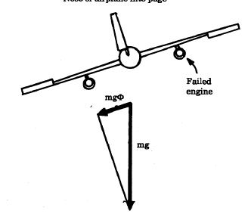
Predicting β_{trim} , δ_{a trim} , δ_{r trim} example (cont’)
But the MIL STD 1797A recommends to stabilize in a trimmed, unaccelerated constant heading flight with a 5 degrees bank angle away from the failed engine.
The reason for banking away from the failed engine is to reduce the burden on the rudder and in most cases (lighter weights) to reduce the side slip and have better stability margins.
Let’s look at the moments in the next slide
Notes:
Engine out salutation produce high burden on the rudder and the vertical stabilizer. β max could also be a factor and could drive high static minimum speeds due to the diminishing Cnβ.
By banking 5° away the failed engine we can significantly reduce the rudder loads and reduce the β trim (and therefore improve the directional stability margins).
Why only 5° and not more ?, the reason is because bank angle reduces the effective lift (Normal force), at higher bank angles the loss of N force could affect the ability of the a/c to maintain slight climb or even straight and level.

Slide 32
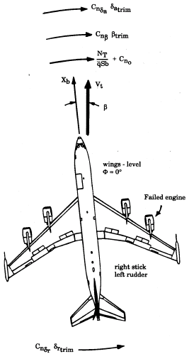
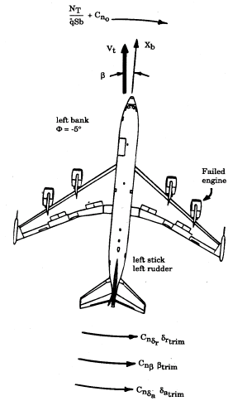
Predicting β_{trim} , δ_{a trim} , δ_{r trim} example (cont’)
φ=0°
φ=5°
Notes:
In this slide we can see at φ = 0°, the β is positive (coming from the right), the rudder power counter all other moments.
At φ = 5°, the β is negative (coming from the left), and now the engine moment Nt counts all other moments which reduce the loads on the rudder and reduces β (light to moderate weight) and improve the directional stability margin.

Slide 33
Predicting β_{trim} , δ_{a trim} , δ_{r trim} example (cont’)
The first limit comes from the Cnβ margin, at SL q=45 for φ=0 (for all weights) and q=43 for 5° bank (heavy).
In lighter weights there is virtually no Cnβ limit when the a/c is banked away.
When φ=0 as altitude increase Cnβ speed limit reduces due to thrust decrease.
When φ=5 as altitude increases Cnβ speed limit increase because bank angle is constant, thrust decrease and we need less opposite rudder to count yawing moment (taking out the bank angle would eliminate the problem)
Notes:
Let’s go back to the β vs q chart.
Now we can see the charts has two sides of β (positive for wing level and negative for 5° bank away the failed engine).
(blue) Look at the wings level part (upper / positve β), the first limit comes from the diminishing power or the limit of Cnβ, it is obviously at sea level highest values of q will be required due to the higher engine thrust.
(green) when banking away in lighter weights there is virtually no β limit and the stall speed will come way before the a/c will reach the max β limit.
(red) in level wings as altitude increases q decreases due to thrust decrease.
(pink) When banked away and heavy weights the minimum speed is very much the same as level wings but at higher altitudes it becomes higher. The reason is because we assume stable 5° away the failed engine. At sea level the bank with rudder counter the engine moments, as altitude increases (and the bank stay the same) the engine thrust become smaller and we are over countering the yawing moment. This could cause to exceed the β limit. Taking the bank out will eliminate the problem.

Slide 34
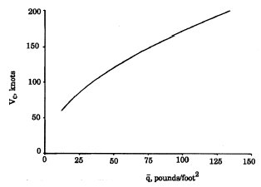
Predicting β_{trim} , δ_{a trim} , δ_{r trim} example (cont’)
Transforming from q to CAS →
For φ=0 (for all weights) we had at SL q=45, so we translate it to 116 CAS.
For φ=5° for heavy weight, at SL we had q=43 which translates to 113 CAS
Vmca could not be less than 116 CAS. Let’s check other predictions.
Notes:
This how we trade q for airspeed.

Slide 35
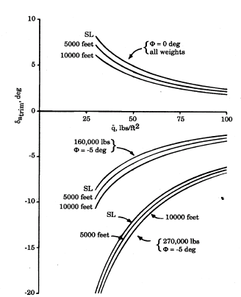
Predicting β_{trim} , δ_{a trim} , δ_{r trim} example (cont’)
Now we’ll predict δa.
The calculations are similar to what we did to calculate β trim.
For φ=0 at SL (all weights) we have positive (right) aileron. It is because the positive β and negative Clβ which ends with left rolling tendency.
For φ=5° at SL (heavy weight) we have negative (left) aileron. The β is negative and negative Clβ which ends with right rolling tendency.
The max deflection is -14° (of the max available 30°), as I briefed before the maximum allowed is 75% (22.5°), so δa does not impose any restriction on Vmca
Notes:
Here we predict δa.
(blue) For φ = 0° (all weights) we have positive right aileron to counter the tendency to roll left. It because of the positive β which generates left roll (due to negative Clβ).
(pink) For φ = 5° (all weights) the β is negative causing a right roll due to the negative Clβ, and therefore we have negative (left) aileron.
In our example the max aileron deflection is -14° (of the max available 30°), not even close to the 75% deflection limit and therefore do not impose any limit on Vmca

Slide 36
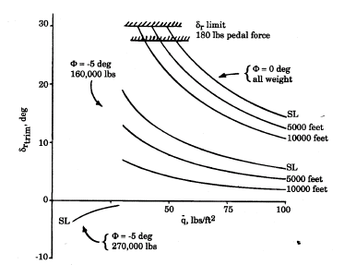
Predicting β_{trim} , δ_{a trim} , δ_{r trim} example (cont’)
Now we’ll predict δr.
The calculations are similar to what we did to calculate β trim.
For φ=0 we get positive rudder input to counter the asymmetric thrust (right engine failed).
As altitude increases minimum q becomes smaller due to reduced thrust.
We can see the limits on δr which are 75% of rudder deflection or force and another MIL STD requirement which is no more then 180 lb pedal force.
Notes:
Here we predict δr.
(blue) For φ = 0° we need positive rudder input to counter the yawing moment.
(green) As altitude increases q becomes smaller due to the smaller thrust.
(pink) The pink ellipse marks the max limits on rudder deflection (and we need not to exceed 75% of the max value) and there is another MIL STD 1797A limit which is max power (on pedals) should not exceed 180 lb force. The reason for this limit is to prevent the pilot from fatigue or exhaustion when flying single engine for long time.

Slide 37
Predicting β_{trim} , δ_{a trim} , δ_{r trim} example (cont’)
Banking away reduces extensively the amount of rudder required.
When φ=5° at light weights, δr is positive (left) but reduced due to the negative sideslip because of the mgφ component and the Cnβ contribution to oppose N_{T}.
As weight increases (mgφ becomes much larger) Cnβ•βtrim +mgφ component are so large they are bigger than N_{T} and we need negative δr (right) to get stabilized.
Notes:
(blue) Banking away the failed engine reduces significantly the amount of rudder required.
(pink) For φ = 5° (light weights) we steel need positive rudder (in our example left pedal) to counter the engine yawing moment,
(green) When a/c weight become heavy and with φ = 5°, mgφ produce a significant component which oppose the yawing moment and it might be we’ll need some right rudder to get stabilized (maintain heading).

Slide 38
Predicting β_{trim} , δ_{a trim} , δ_{r trim} example (cont’)
Now after calculating the trimmed speed limits we can put them in one table and decide which one is our trimmed speed limit.
Sea Level, all weights, level wings:
Cnβ limit ………. 116 Kt
δr limit ………… 120 Kt
PFr limit ………. 125 Kt (pedal force)
Sea level, heavy weight, φ=5°:
Cnβ limit ……… 116 Kt
Notes:
We need now to determine which limit from the many static limits we have is the highest.

Slide 39
Predicting β_{trim} , δ_{a trim} , φ _{trim}
I am sorry, we are not done yet with the predictions, one more task to do.
The MIL STD 1797A requires engine out flight should be possible with out using rudder at speed less than 1.4•Vmin.
Vmin defined as 1.1•Vstall.
We need to predict if the trimmed conditions with δr=0 are in agreement with this requirement.
In our example (B707) the stall speed for 270,000 lb is 110 Kt (T.O.), and Vmin (δr=0)=1.4•1.1•110(T.O.)=169 kt
Notes:
If you thought we are done with the static calculations you are wrong, we are not done yet.
Look at the MIL STD requirement in (blue).
This limits is important because from real life we know when engine fails the first pilot reaction to the thrust loss is opposing yaw and roll tendency (due to β which cause roll tendency due to Clβ) with ailerons.

Slide 40
Predicting β_{trim} , δ_{a trim} , φ _{trim} (cont’)
It is impossible to trim the a/c for an engine out, level wings and constant heading flight with out using rudder. The a/c must be banked away from the failed engine.
We now calculate how much bank do we need? trimmed side slip? and aileron required ?
Notes:
Recall how we define stable trimmed flight – steady heading. We saw from the calculations it is impossible to fly trimmed flight with level wings (no mgφ component) and no rudder input.
It should be possible to maintain trimmed flight with banking away the failed engine.

Slide 41
Predicting β_{trim} , δ_{a trim} , φ _{trim} (cont’)
Recall the equations of a trimmed flight →
Set δr=0 →
Notes:
Recall the restricted equations we used.
Setting δr = 0 zeroize the δr dependent derivatives.

Slide 42
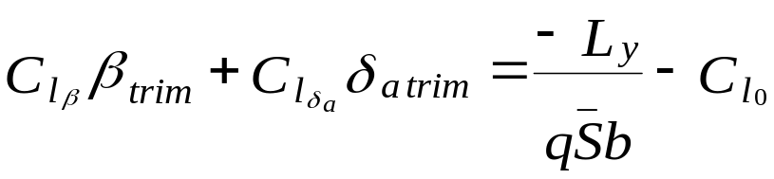
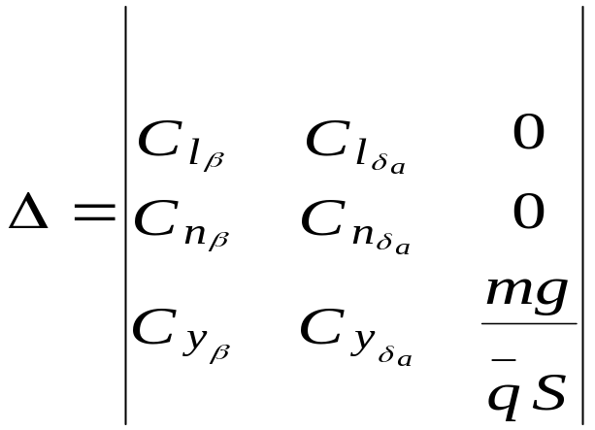
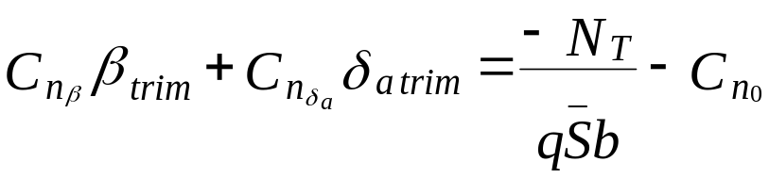
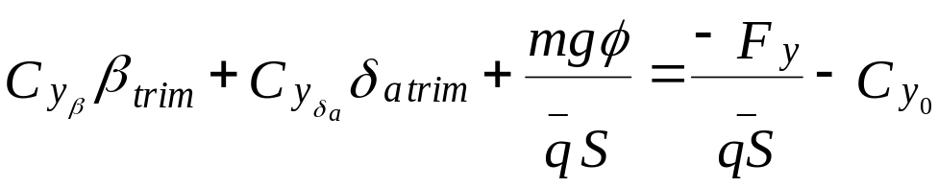
Predicting β_{trim} , δ_{a trim} , φ _{trim} (cont’)
Move the mgφ to the left side because we now use bank angle instead of rudder to counter side force →
The Δ takes the form of ↓
Notes:
Basically it the same solving process we did before.

Slide 43
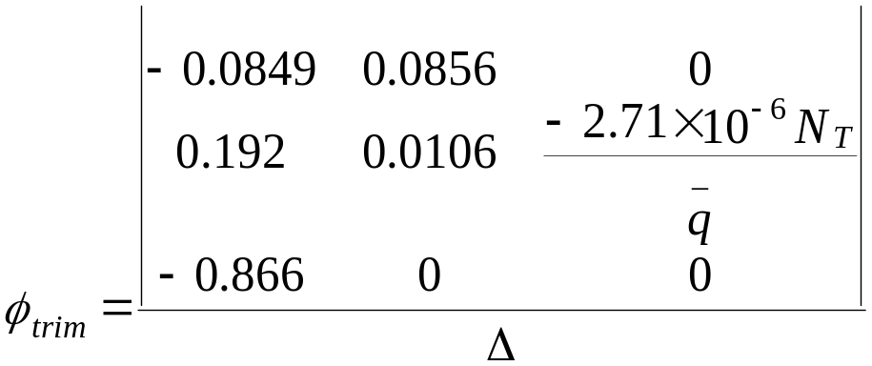
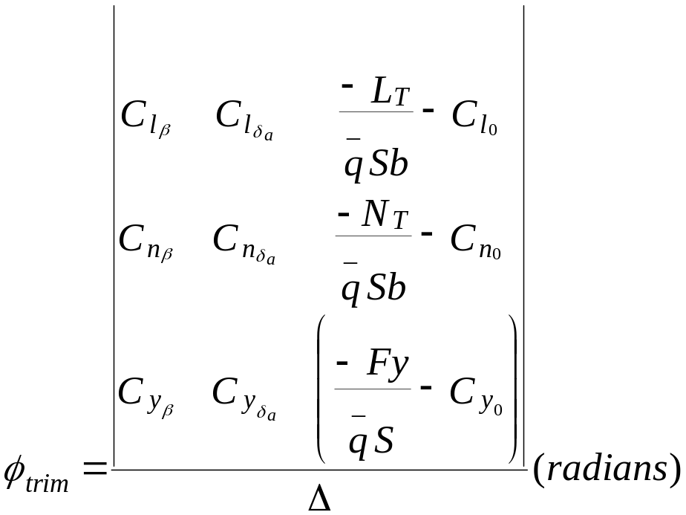
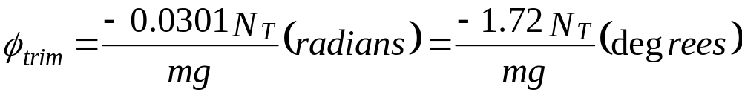
Predicting β_{trim} , δ_{a trim} , φ _{trim} (cont’)
Solving for βtrim, δa trim and φ trim (using Cramer rule) →
(I’ll show here only φ trim calculation, β trim and δa trim are similar)
Notes:
Solving for β trim, δa, and this time for the desired bank angle φ (instead of δr)
Lt = 0 because we are talking about a stable trimmed flight with no rolling moment.
The Fy = 0 because we are balancing the side force with opposing force due to our banking away and there fore we have mgφ component which oppose the side force.

Slide 44
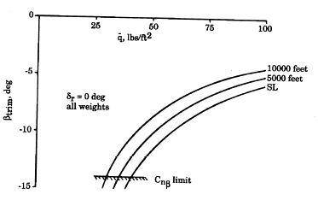
Predicting β_{trim} , δ_{a trim} , φ _{trim} example
This is the β trim prediction for δr=0 →
The side slip is negative as expected due to banking away (to the left).
For given q, side slip increase as altitude decrease because we need more side slip to counter the higher thrust and side force.
The limit on β is because of the diminishing Cnβ and in this case at SL q=43 which is equal to 113 Kt.
It is easily satisfy the MIL STD requirement to be less than 1.4•Vmin which was in this case 169 Kt
Notes:
(blue square) We are at stable condition so β obviously negative (from left) therefore we need to bank to the left (away the failed engine).
(pink) For given q as altitude decreases β increases due to the higher asymetric thrust. The β limit come in a point where Cnβ start to diminish.

Slide 45
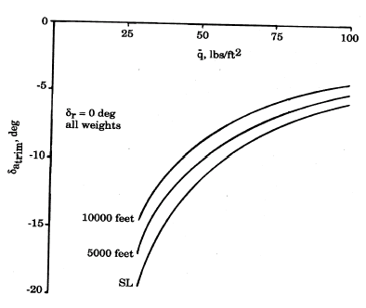
Predicting β_{trim} , δ_{a trim} , φ _{trim} example (cont’)
This is the δa trim prediction for δr=0 →
We need negative δa (left aileron) which is make sense since we need to oppose Clβ which tend to roll the a/c to the right due to negative β.
For given q, δa increase as altitude decrease because we need more aileron to counter the higher Clβ due to higher β due to higher thrust.
We can see that the max aileron we need is 20° which is way less than the 75% of the max deflection (30°) so in this case there is no limit on the Vmca.
Notes:
(blue square) Because β is negative and Clβ negative we get positive rolling tendency, Therefore we counter it with left aileron.
(pink) Also here δa increases as altitude decreases due to the higher thrust.

Slide 46
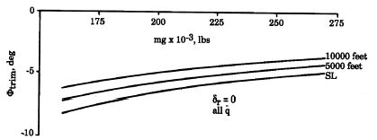
Predicting β_{trim} , δ_{a trim} , φ _{trim} example (cont’)
Weight
The trimmed bank angle is obviously to the left (away the failed engine).
Higher weight, less bank angle required because β value determined by the N_{T} and than mgφ is required to counter Fy. Higher mg, smaller φ.
As altitude increase bank angle decrease because thrust get smaller, N_{T} smaller, β smaller and therefore less bank required.
The max φ required to stabilize the a/c is 8° which can easily achieved therefore trim in this situation is not a problem.
Notes:
Predicting the required bank angle φ.
(blue square) Obviously banking to the left (away the failed engine).
(pink) As a/c weight gets heavier we need less bank angle. The reason is β value determined by the Nt moment, the mgφ component opposing β. As a/c mass “m” getting higher φ becomes smaller for the same β.
(green) As altitude increases φ decreases due to the reduced thrust.
Now we are done with all our static calculations and ready to proceed to the transient response (dynamic).

Slide 47
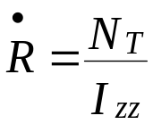
Predicting transient response
Recall yaw acceleration equation:
When flying trimmed constant heading, both sides of the equation = 0, when engine fails the immediate response is :
As thrust gets higher (low altitude, cold air) and weight gets lower (lower Izz) the initial yaw rate acceleration will become much more aggressive.
Recall the MIL STD requirement of at least 1 second before corrective action could be performed.
And recall the MIL STD requirement of controls left over, the purpose is to be able to control the transient response.
Notes:
In simple words we want to simulate critical engine failure when critical engines are at max power, wait 1 second apply corrective controls and be able to bring the a/c back to a trimmed flight by using the controls only.
The conditions where engines produce their max power are low altitude cold air.

Slide 48
Predicting transient response (cont’)
The best prediction of the transient response could be achieved in the simulator.
In addition the ability to control the response requires pilots proficiency and course of action.
The test crew should decide on the course of action strategy and train in performing it in the simulator.
Notes:
The characteristics of the transient response are initial large yaw rate, large roll motion and some drop in pitch attitude.
The best way to get prepared to the transient response is to train in a simulator. In this training the test crew has to develop the required crew coordination, flight techniques and methods which will ensure a controlled build up in flight conditions, proper control inputs to every uncontrolled motion, and correct emergency recovery actions incase the normal control inputs do not bring the a/c back to a controlled flight.

Slide 49
Predicting HQ
The MIL STD requires HQ following engine failure should be adequate to bring the a/c for a safe landing.
The prediction is by using the RSmith criteria (recall our HQ brief).
In our example a B707 at 5000 ft, weight – 160000 lb and speed of 120 Kt loses critical engine.
I did roll control analysis and determine the slope of S (between 1 and 6 rad/Sec) as -11.5 db/octave. The ωc was 3.24 rad/Sec and phase angle of -170°.
I found no PIO tendency.
The bode plot and the CHR equivalent are on the next slide.
Notes:
Similar to what I briefed in the HQ session, we can evaluate the single engine HQ buy using the RSmith criteria.
We start with HQ evaluation in a simulator.

Slide 50
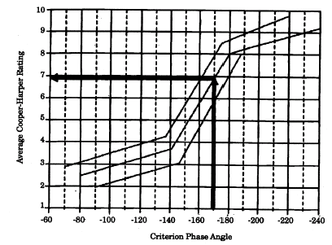
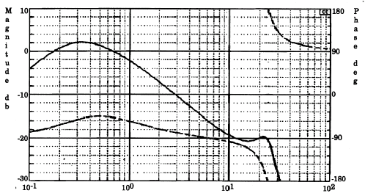
Predicting HQ (cont’)
S db/octave
ωc
A simulator evaluation is required for HQ using Phase I, II and III.
After we are satisfy with the transient response and control strategy , satisfy with HQ and we have predicted minimum stabilized engine out speed we are ready for flight test.
Notes:
We can continue to flight test only when we are satisfied with static stability, transient response and HQ.

Slide 51
Vmca FTT
Vmca is a risky test and we use the following build ups:
  From higher altitude to lower altitude (usually starts at 10000 ft).
  From higher speed to lower speed (usually starts 40 knots above predicted Vmca).
  Testing FTT’s in the following order : Vmca static, Vmca dynamic and Vmca HQ.
Usually (but not limited) the configurations will be approach and or landing (recall in T/O config’s usually but not always the stall speed will be much higher than Vmca).
Notes:
Build up again and again.
We mentioned earlier the most critical situation for engine out. The combination of light weight, slow speed and low altitude conditions are mostly probable during a/c go around.
There fore a/c configuration during go around should be selected for the test. In some cases also takeoff configuration should be selected.

Slide 52
Vmca FTT (cont’)
Test points selection:
Vmca dynamic & HQ
test points
Vmca static
test points
Stall
Speed
Altitude
Airspeed

Slide 53
Vmca static FTT (cont’)
Static Vmca FTT (2 engine a/c)
  Stabilize at initial speed 500 ft below test point altitude.
  Retard one throttle slowly to idle and stabilize the a/c in a wing level constant heading flight. If required shut down the engine.
  Push the other throttle slowly to max power, maintain level wings, heading and start to deplete speed (by entering a climb ) of 1 Kt for every 2 seconds.
  When max allowable deflection or force achieved start to bank away from the failed engine up to φ= 5°
  Maneuvers ends at Vstall or at speed with max control inputs with φ= 5°.
  Record flight data, control position, forces, rates etc.
Notes:
There is some difference between 2 engine a/c test technique and 3 engine or more FTT.
In 2 engines a/c we must set one engine to max power (to achieve maximum asymmetric thrust), this results in a climb during the test run (static, dynamic, and HQ), so it makes runs more complex and hard to stabilize and a tendency to exceed the tolerances and databands. The reason for starting below the test point is to allow the pilot to get stabilized in flight conditions before reaching the test point altitude.

Slide 54
Vmca static FTT (cont’)
Static Vmca FTT (3 engine or more a/c)
  Stabilize at test point altitude at initial speed.
  Retard inside engines to desired mid position.
  Retard critic engine throttle slowly to idle and stabilize the a/c in a wing level constant heading flight. If required shut down the engine.
  Push the opposite throttle slowly to max power, maintain level wings, heading and start to deplete speed of 1 Kt for every 2 seconds.
  When max allowable deflection or force achieved start to bank away from the failed engine up to φ= 5°.
  Maneuvers ends at Vstall or at speed with max control inputs with φ= 5°.
  Record flight data, control position, forces, rates etc.
Notes:
In 3 or more engines we only set the outboard engine to max power and the inboard engines to the required thrust which allow the a/c to stabilized in straight and level or slight climb flight conditions.

Slide 55
Transient response (dynamic) Vmca FTT
Dynamic Vmca FTT (2 engine a/c)
  Stabilize in speed 500 ft below test point altitude at initial speed.
  Push both engines to max power. Maintain test point speed.
  At desired altitude PM shut (or select idle thrust of) the engine. FTE counts the time.
  PF start with recovery inputs using controls only.
  A/c must be stabilized in a wings level (or φ=5°) constant heading flight with velocity vector in slight climb or level (no descent).
  Before each test point different flight data should be assessed to determine the safety of proceeding to the next point (no room or time to brief all the build ups here).
  Record flight data, control position, forces, rates etc.

Slide 56
HQ Vmca FTT
HQ Vmca FTT:
  At engine out test point flight conditions perform
  Phase 1 – turns, over turns, heading captures, enter climbs and descent, pitch captures and basic IFR flight.
  Phase 2 – perform tight formation flight, and AA gunnery
  Phase 3 – tight formation, and AA gunnery

Slide 57
If something goes wrong
If altitude permits immediately reduce asymmetric thrust. And reduce angle of attack allowing the a/c to accelerate and give more control power to the rudder and aileron.
Stopping high yaw rate is crucial.
High bank angles could result in steep dive angle, watch bank angle. At high angle of attack and low speed use rudder and aileron to control bank angle.
Notes:
Those emergency recovery actions trainings must be performed in a simulator prior to the test.
One important point is to define a clear cut flight parameters which will drive the test crew to perform the emergency recovery actions when the a/c is still recoverable.
Usually we will define limits to yaw rate, bank angle, and angle of attack. Any excess of this limits will cause the test crew to perform the recovery actions. Monitoring those parameters in real-time is essential and could be performed from a ground station by using real-time telemetry or onboard instrumentation which allows the test engineer to monitor those parameters real-time.

Slide 58
QESTIONS ?

Slide 59
Disclaimer
This brief was planed to be presented after the stability and dynamics briefs which put the bases for this session.
Because of the change in the course program we brief it a had and few terms might be unexplained.
We won't cover them here but I’ll say it will be briefed later on the course.

